Slide 1

CS 313 E
Term Project
EID: ahm2466
EID: rns2365
Anaya Malik
Ridisha Saquib

Slide 2
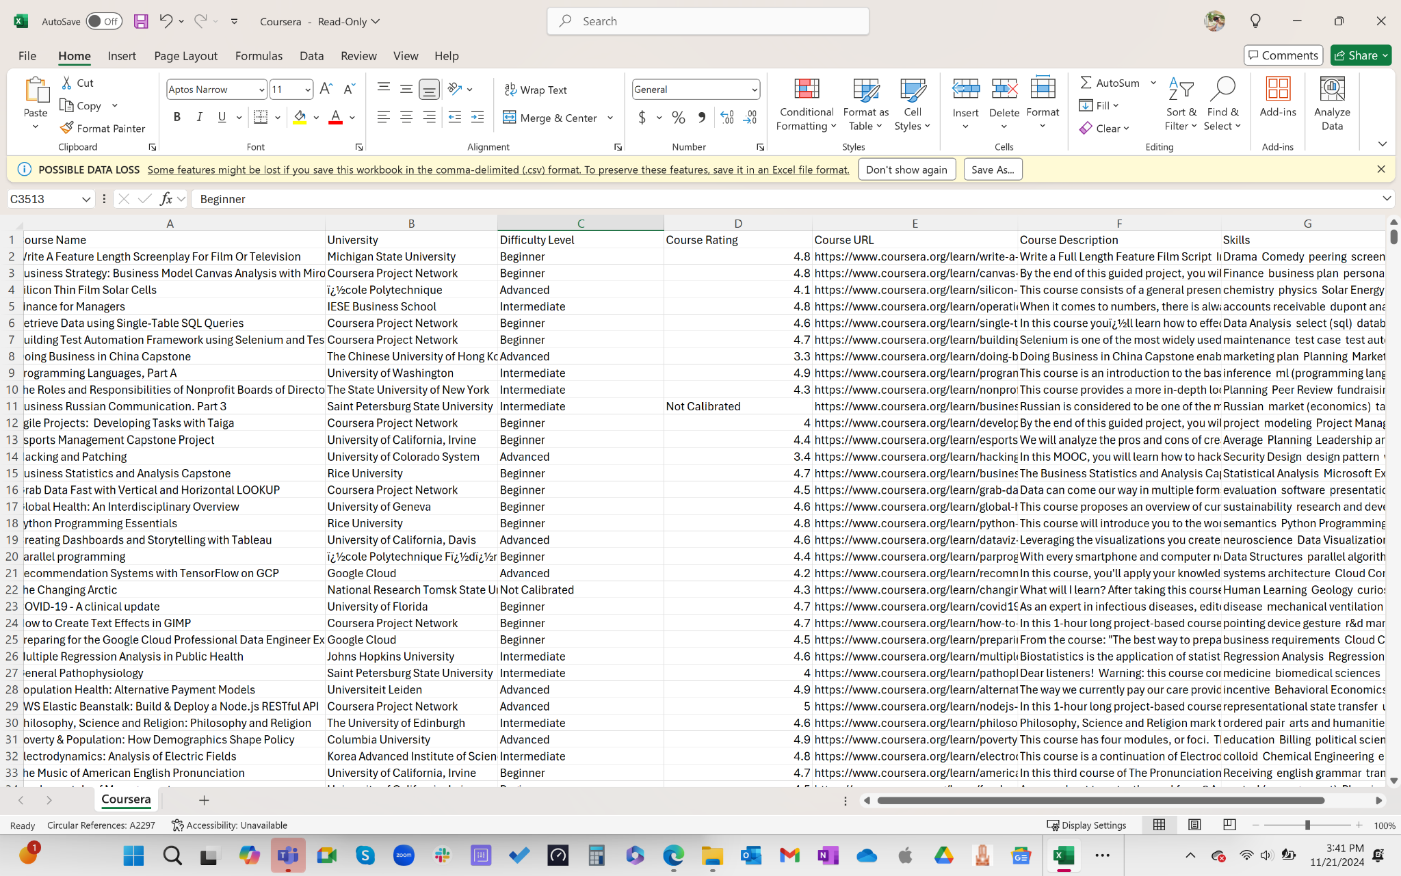
Coursera Project
Notes:
Why we wanted to do project - make it easier to find good notable courses on coursera because it can be an overload of information
We acquired our data set through kaggle in which you can download it and itll be downloaded to a csv file automatically - you can store this file in the same location as the code file
We used the pandas library - which we used for the first time - which helped us access the data from the csv file into our python file
Some weaknesses we had invvoled data cleaning - a lot of data you acquire isnt clean so we had to make sure our data was good to go - Had to make the course rating into a numeric format in order to ensure we could manipulate the data accrodinlgy
Just wanted to gain experience working with data in python!

Slide 3
Project Idea
Recommendation system for Coursera courses
User inputs keyword
Filters courses by giving top 15 courses with over a 4.0
Linear Search to find courses
Dictionary → {course name: rating, level}
Max Heap structure on ratings
Courses displayed in a list
Notes:
Our idea was to ask the user for a keyword to help refine their search and only give the top 15 courses that had a 4.0 rating to give the user a recommendation of the best courses to use
We decided to use linear search (which we learned in class) in order to filter through the data and find titles that matches with the keyword the user had given
Once we filtreed through the data to get the titles that included the key word we used 3 data structured
1 being a dictionary in order to firstly store the filtreerd data by name and rating
2 being max heap in order to store the courses by their rating to have the best rated courses at the top and the the lesser rating oursses sequiernly underneath the root node
3 being a list which we use last to display the recommended courses after we get them from the heap

Slide 4
Code Structure
import pandas as pd
#finding csv file path
def load_in_data(file_path):
class MaxHeap:
def __init__(self):
def insert(self,course_name,course_rating,course_difficulty):
def _heapify_up(self,index):
def extract_max(self):
def _heapify_down(self,index):
def filter_data(df,keyword):
# DICTIONARY
def search_courses(courses):
# HEAP
def display_top_courses(sorted_courses. top_n=15):
# LIST
#test cases
def main():
if__name__ == “__main__”:
main()
Notes:
Title and bullet point text

Slide 5
Run
Software
Notes:
Big text and subtitle. You can add graphic resources to the composition (photo or vector)

Slide 6


Slide 7
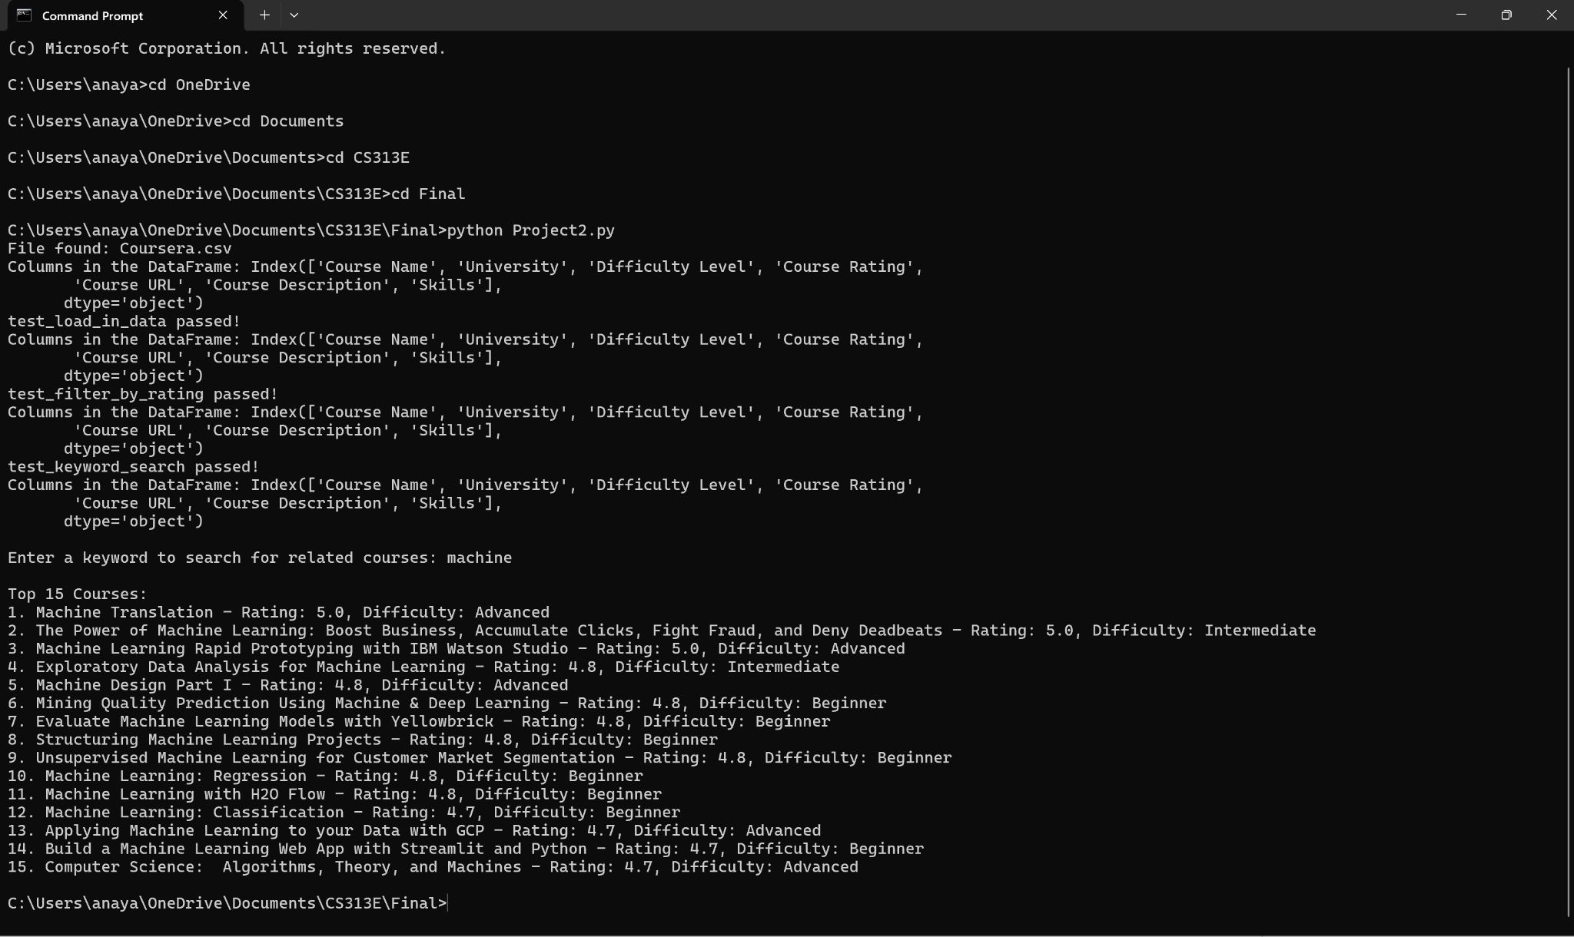
Results
Notes:
Interpret the results: the first couples lines are the test cases proving that the code works (just prove that code works here) and then the user will get a prompt to give a single keyword to help refine their search
Our code will then provide the top 15 course titles which all have a 4.0 rating of the given keyword (the keyword is looking at the titles of the courses) - only will strictly show 4.0 even if there isnt 15 of them but if there smore than 15 then it will only show the top 4.0 15 courses to not have an overload
To improve our results we could allow the user to ask more keywords or we could do front end coding to make our results look nicer by creating an application or ultizing good UX/UI design to make our code easier to interact with

Slide 8
THANK
YOU!

Slide 9
References
https://www.kaggle.com/datasets/khusheekapoor/coursera-courses-dataset-2021/data
Notes:
Our idea was to ask the user for a keyword to help refine their search and only give the top 15 courses that had a 4.0 rating to give the user a recommendation of the best courses to use
We decided to use linear search (which we learned in class) in order to filter through the data and find titles that matches with the keyword the user had given
Once we filtreed through the data to get the titles that included the key word we used 3 data structured
1 being a dictionary in order to firstly store the filtreerd data by name and rating
2 being max heap in order to store the courses by their rating to have the best rated courses at the top and the the lesser rating oursses sequiernly underneath the root node
3 being a list which we use last to display the recommended courses after we get them from the heap

